Slide 1
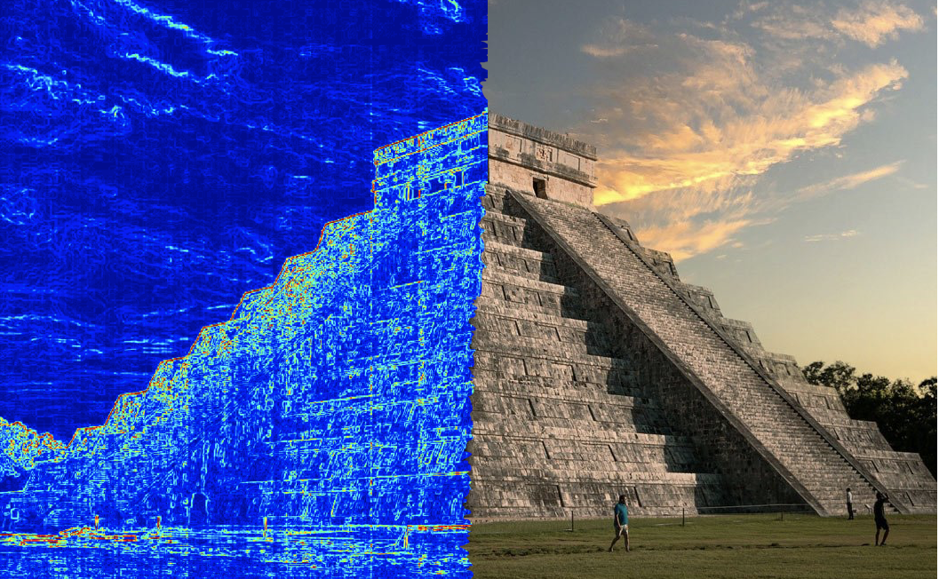
MayaVision
Riley C. W. O’Neill
2nd year applied math PhD student
oneil571@umn.edu
Group 11
Notes:
Image source: https://sandinmysuitcase.com/mayan-ruins-in-the-yucatan/
(image gradient added)

Slide 2
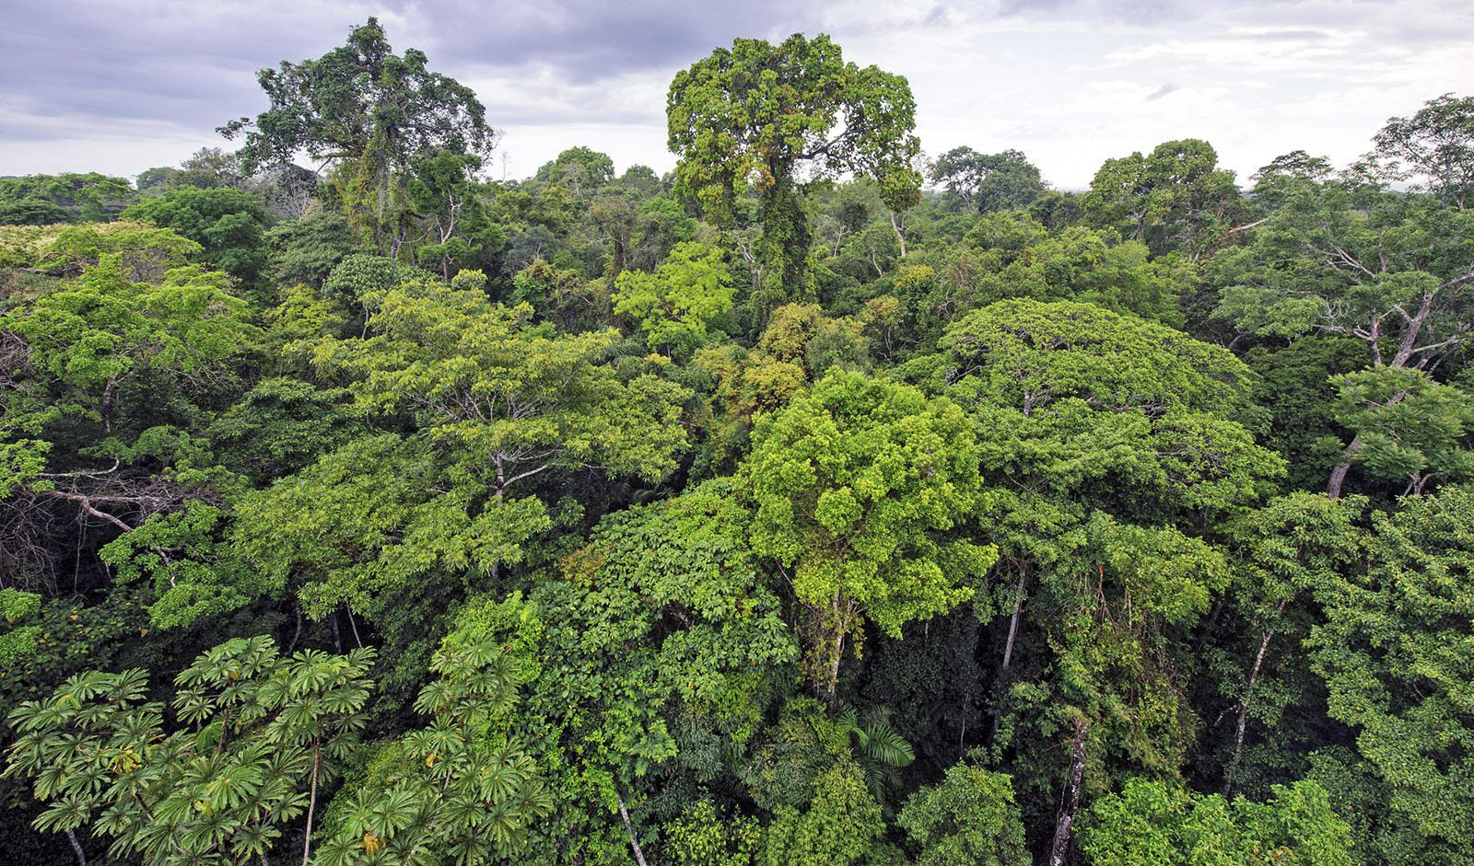
Goal: Find What’s Hidden
~ The dense forests of Central America hide thousands of as-of-yet explored Mayan ruins. Even after 80 years of intensive study in certain regions, overgrowth has made it so that one can be standing atop a small pyramid and not realize it.
~ Rapid advances in scanning technologies like LiDAR are revolutionizing the way archaeology is done.
~ This project aims to leverage state-of-the-art convolutional neural networks with satellite and LiDAR data for semantic segmentation of Mayan ruins - not just detect them, but classify what they are.

Slide 3
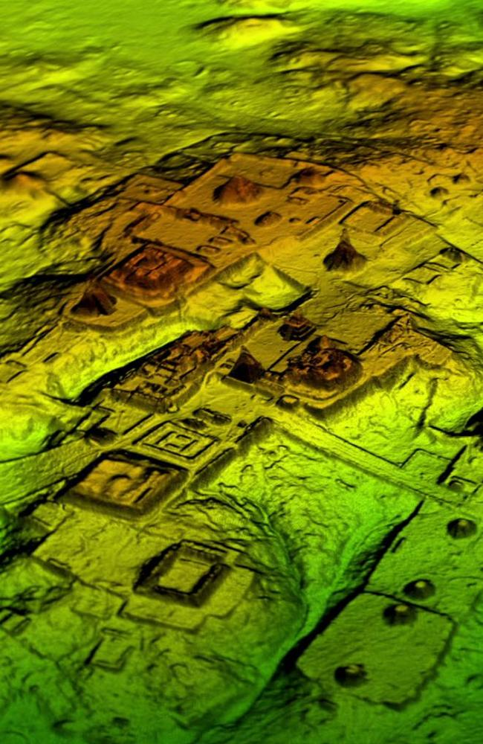
Background
2016 - Pacunam Lidar Initiative (PLI) - scanned 2144 km^2 of Mayan lowlands in Guatemala [1]
2018 - Study released: found 61,480 structures [1]
2020 - Machine learning first applied to [1]’s dataset [2]
2021 - “Discover the Mysteries of the Maya” ML contest [4]
Notes:
Photo source: https://www.news.com.au/technology/science/archaeology/lost-mayan-cities-in-guatemala-discovered-in-laser-probe-of-jungle/news-story/955d96521488233999d89e58f47eb6b8

Slide 4
How Has This Been Done?
Canuto et al. [1] used known sites as ground truth to calibrate features used in identification from LiDAR. Manual viewing and labeling done by experts over the period of several months in two iterations. Classes: structures, natural defense, built defenses. defended areas, causeways, reservoirs, uplands, wetlands, agricultural uplands, agricultural wetlands. Verification by excavation/exploration. Data available in TIFF and ESRI shapefile format [3].
Drawback: very slow, time consuming.

Slide 5
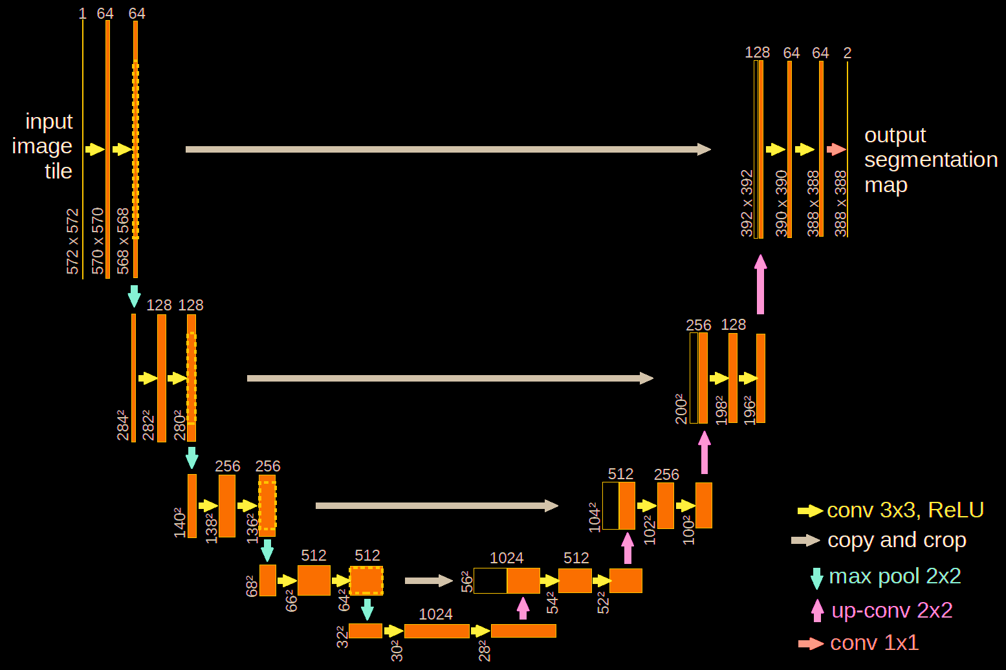
ML Approach With LiDAR Alone
Bundzel et al. [2]: used [1]’s data. Semantic segmentation via a U-Net (also tried Mask-RCNN). Output masks to identify structures (buildings + platforms) and mounds (buildings). 670 mounds for training/validation, 1400 mounds for testing. Variety of losses. 1,177,649 parameters, 49 layers. Correctly classified 66% of all objects, 81% of medium sized objects.
Drawback: Not phenomenal accuracy.

Slide 6
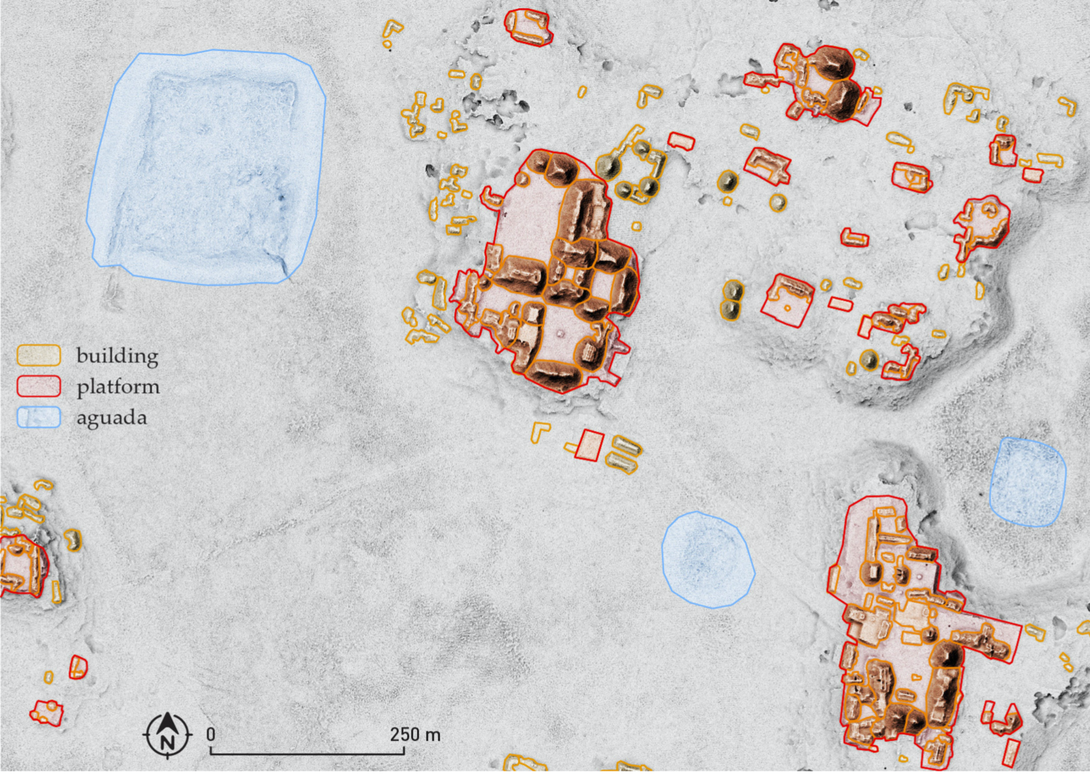
Another Dataset, Another Approach:
Somrak et al [5]. Smaller study than [1], located in Chactún, Mexico. Broke into 17,000 images, manually labeled from LiDAR data. Classifying buildings, platforms, & auguadas (ponds). Fine tuning with VGG-19. 95% accuracy.

Slide 7
Mysteries of The Maya Competition
Based on [5]’s work, but adds satellite data to LiDAR. 240x240m image tiles.
Aerial LiDAR resolution: .5-1m resolution. Why wouldn’t you use it?
Sentinel Satellites: European Space Agency, up to 10m resolution.
Sentinel 1: Synthetic Aperture Radar (SAR). 12 spectrum bands, non-weather dependent. Turned into yearly statistics on each tile for 2017-2020
Sentinel 2: more MSI & SWIR sensors. Visible-mid infrared. BUT: extremely sensitive to clouds. Only 17 usable days from 2017-2020 for region (with <5% cloud cover).

Slide 8
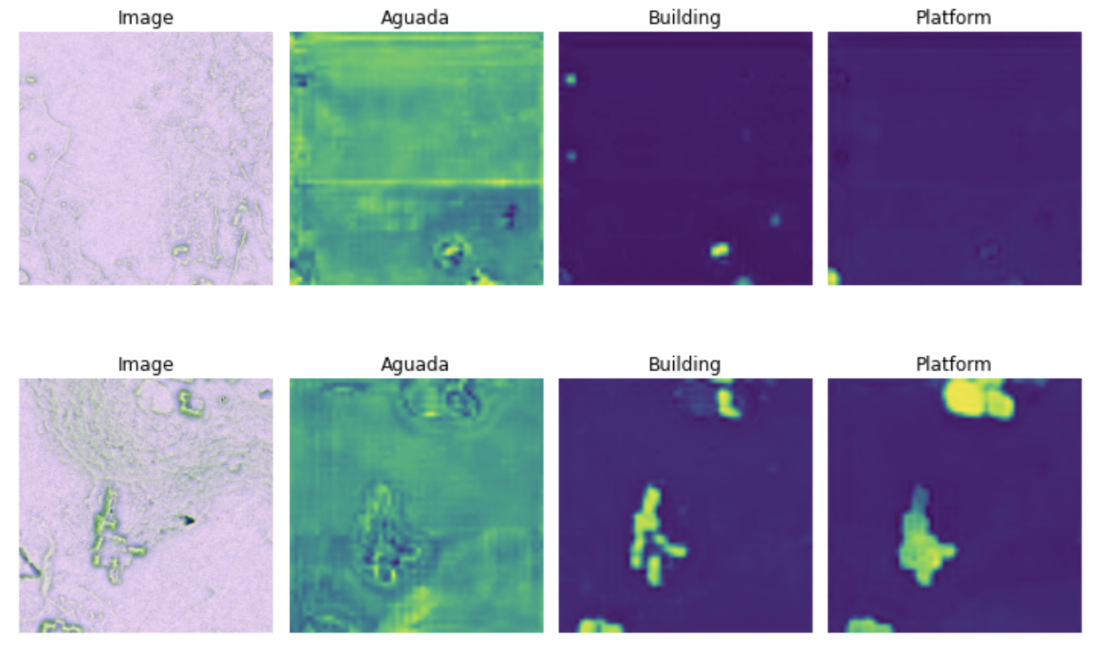
Mysteries of the Maya Baseline
Competition baseline: 76.787% overall IOU accuracy. 98.47% aguadas, 65.87% platforms, 66.00% of buildings. Used Deeplabv3-ResNet101.
Best results from competition: 83% overall IOU accuracy. 98.44% aguadas, 76.51% platforms, 75.30% of buildings. Methods not yet released.

Slide 9
My Approach:
0. Hourglass model CNN (new), IOU or similar loss. 80/20 training/testing splits.
1. Train preliminary semantic segmentation neural network on Mysteries of the Mayans dataset using: A. Sentinel satellite and LiDAR data, and B. just LiDAR data.
2. Get Sentinel data corresponding to Canuto et al [1]’s regions (new).
3. Train and evaluate model on [1]’s data for various classes (with or without satellite data, depending on results).

Slide 10
Gauging Success:
Semantic segmentation will be run on [1] and [5]’s datasets. A subset of [1]’s classes will be likely be examined (e.g. only platforms or mounds; more will be explored as time permits).
The outputs will be compared against the manually made expert binary masks for each class. Evaluation will use IOU and similar metrics.

Slide 11
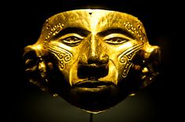
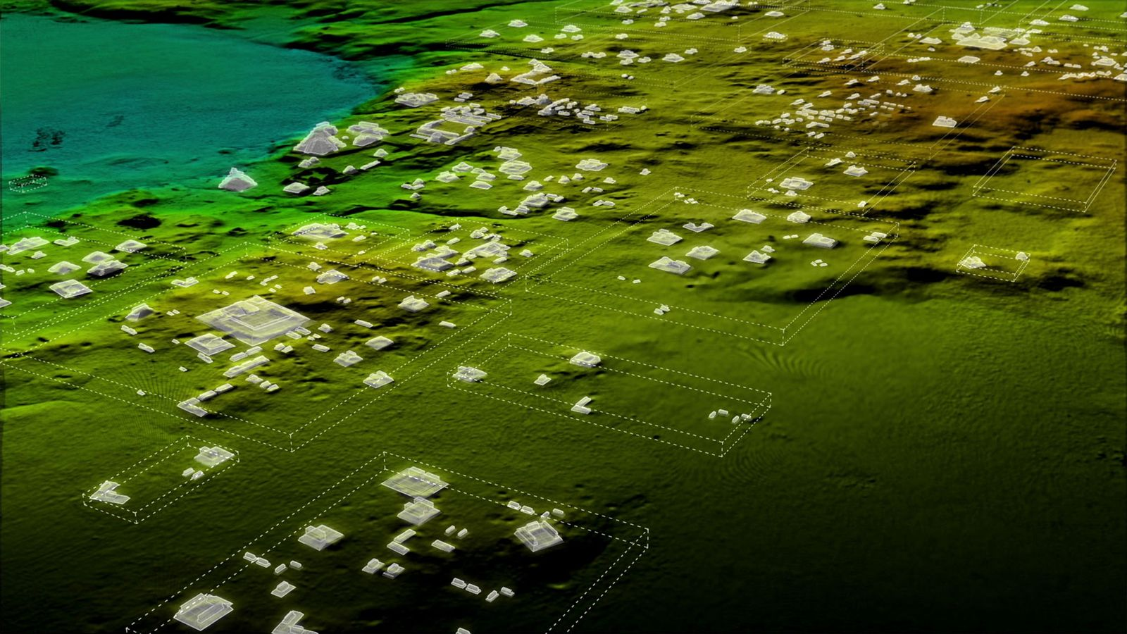
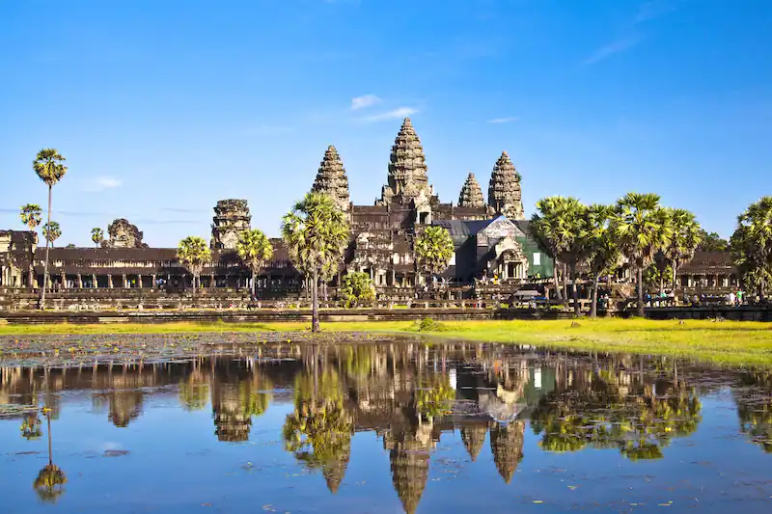
Impact
~ Directly applies to finding other ancient sites in tropical forests (rest of Central/South America, Southeast Asia)
~ Potential to change history
~ Other LiDAR and topographical segmentation applications; undersea archaeology

Slide 12
References
1. Canuto et al. Ancient lowland Maya complexity as revealed by airborne laser scanning of northern Guatemala. Science, 2018. [Link]
2. Bundzel et al. Semantic Segmentation of Airborne LiDAR Data in Maya Archaeology. MDPI, 2020. https://www.mdpi.com/2072-4292/12/22/3685/pdf
3. Canuto et al. Data from: Ancient lowland Maya complexity as revealed by airborne laser scanning of northern Guatemala. 2019. [Link]
4. Discover the Mysteries of the Maya Challenge. ECML PKDD, 2021. https://biasvariancelabs.github.io/maya_challenge/bckg/
5. Somrak et al. Learning to Classify Structures in ALS-Derived Visualizations of Ancient Maya Settlements with CNN. MDPI, 2020. https://www.mdpi.com/2072-4292/12/14/2215

